Slide 1

Hotel booking for a Resort Hotel & a City Hotel in Portugal
June 20th 2024

Slide 2

Introduction
There are 4 analysts deciphering data
Lavanya Bhanot
Deogratius Nteza
Xuan (Sam) Chen
Judy Pin
Lavanya
Notes:
Lavangia –introduction
Deo - explain the data

Slide 3

Data Explanation
Deo
Notes:
Deo

Slide 4

TBD Title Sammy

Slide 5

Spend Judy

Slide 6
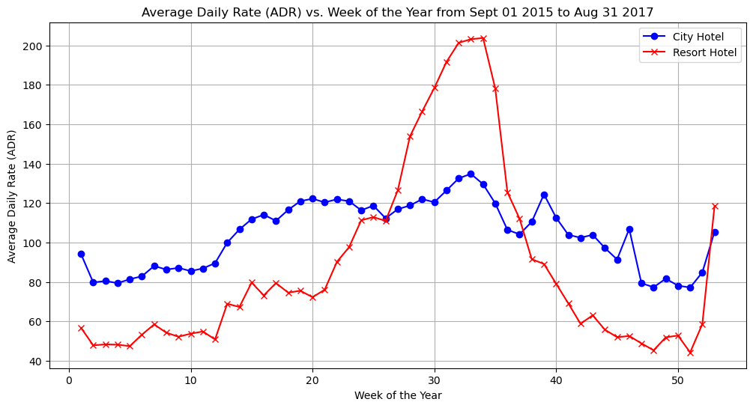

Slide 7
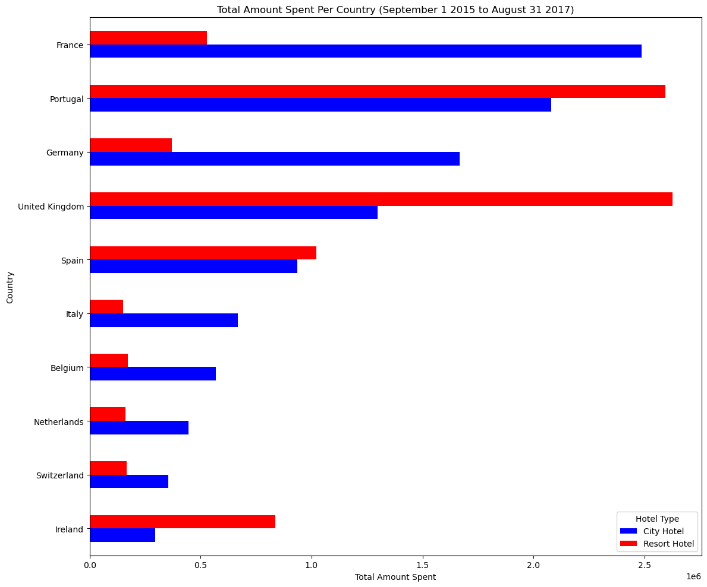

Slide 8
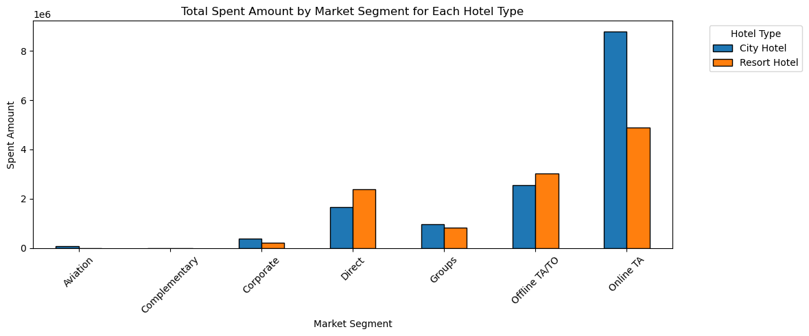

Slide 9
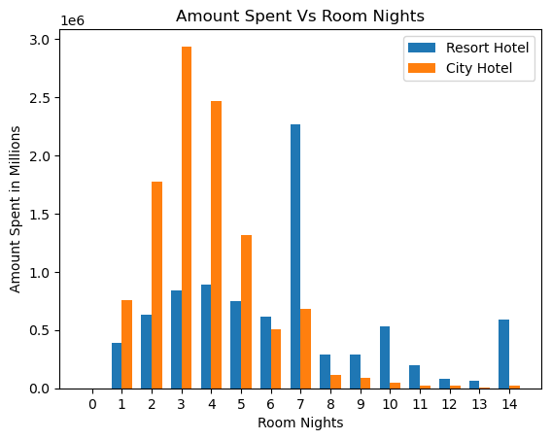

Slide 10

TBD Title Lavanya

Slide 11
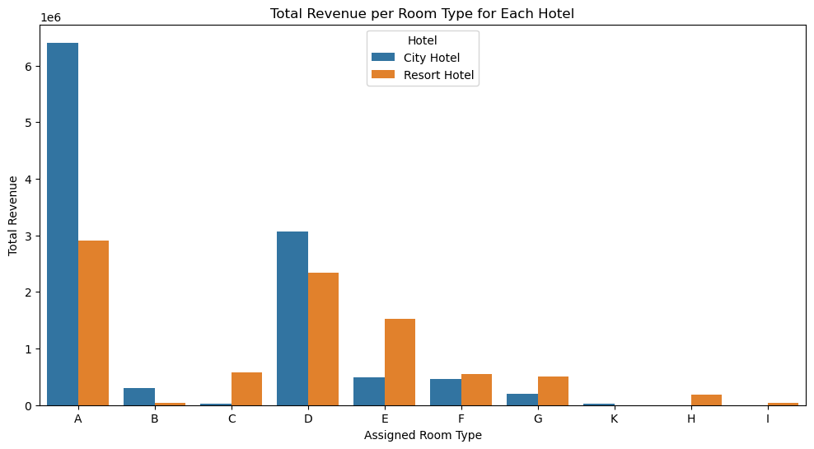

Slide 12
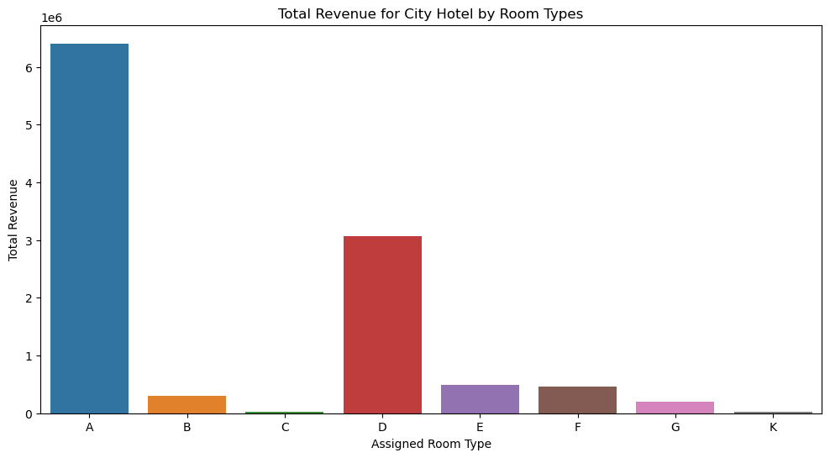

Slide 13
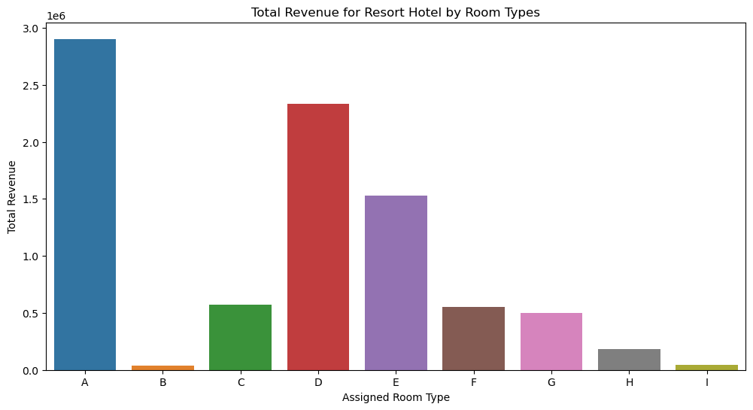

Slide 14
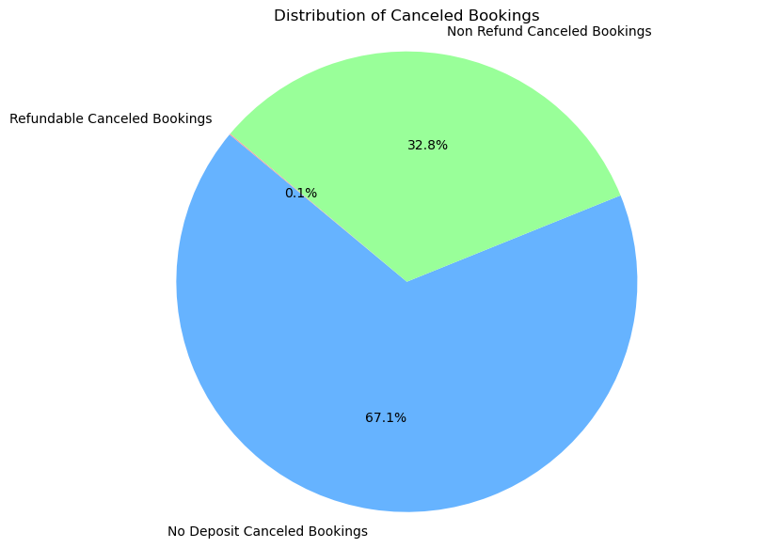
Total Canceled Bookings: 44224
Refundable Canceled Bookings: 0.08%
No Deposit Canceled Bookings: 67.14%
Non Refund Canceled Bookings: 32.77%

Slide 15
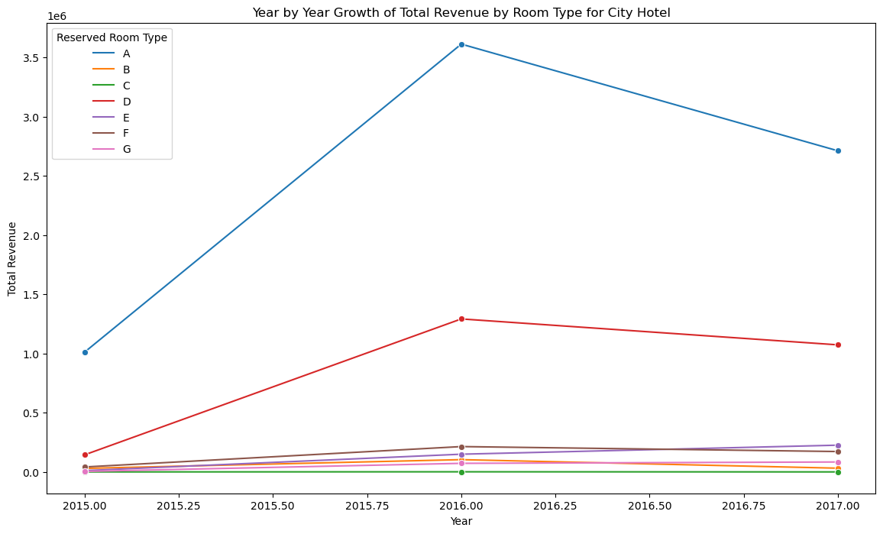

Slide 16
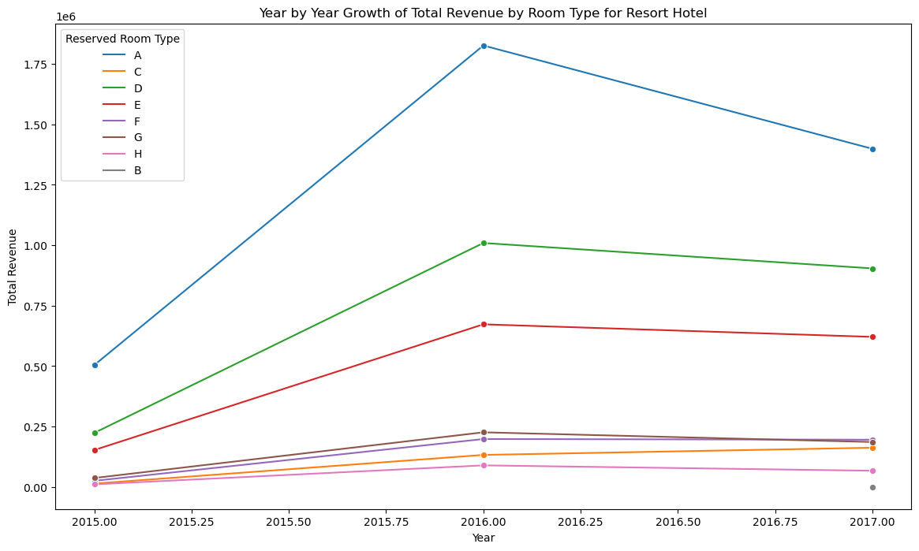

Slide 17
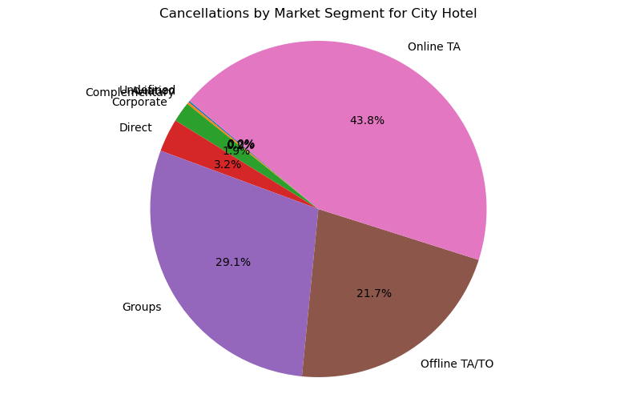

Slide 18
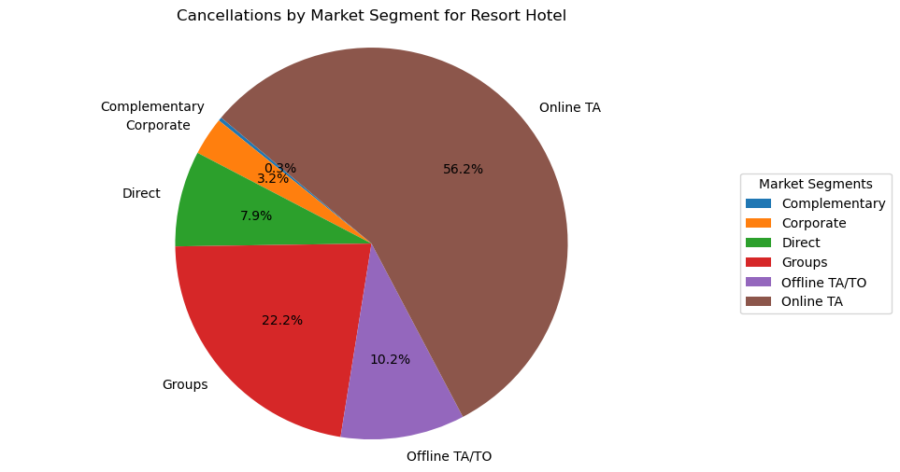

Slide 19
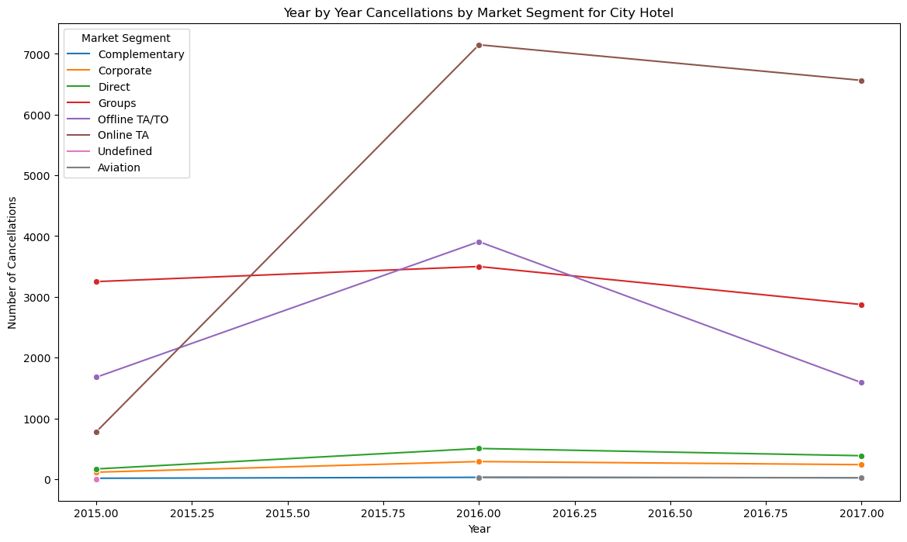

Slide 20
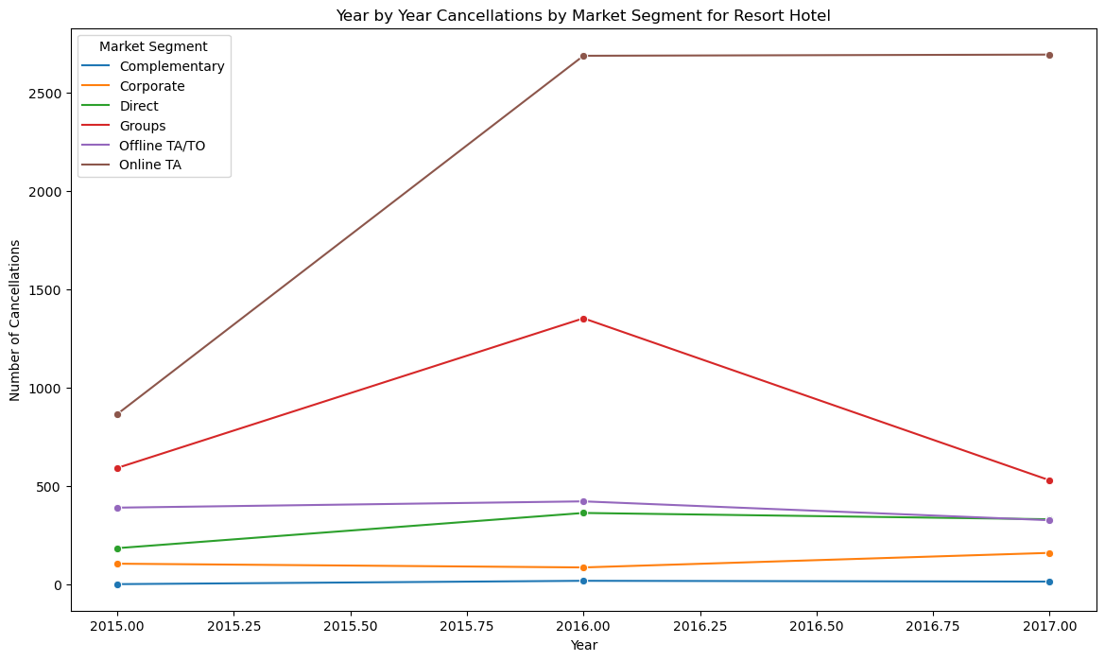

Slide 21
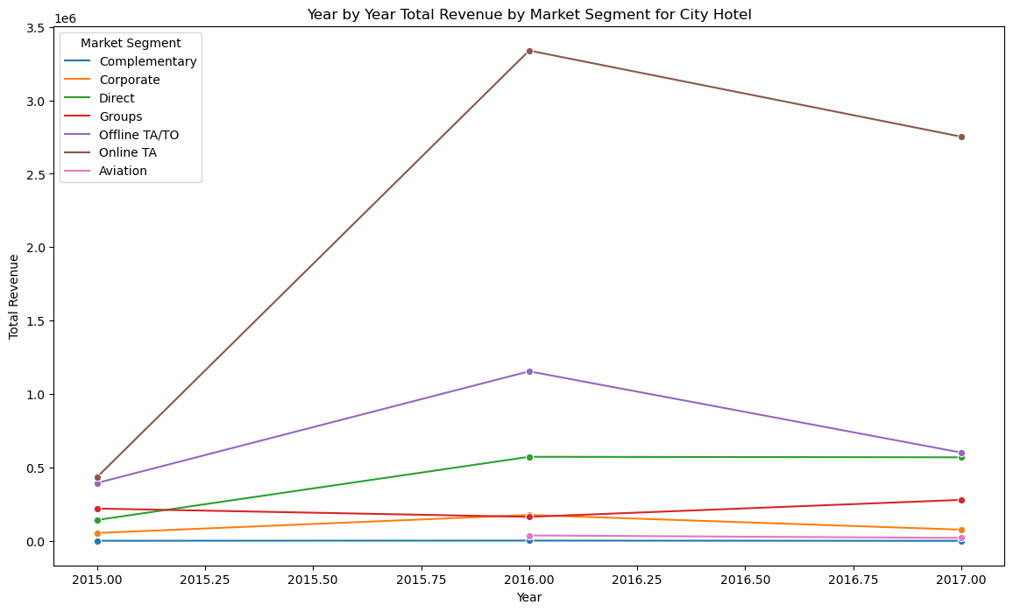

Slide 22
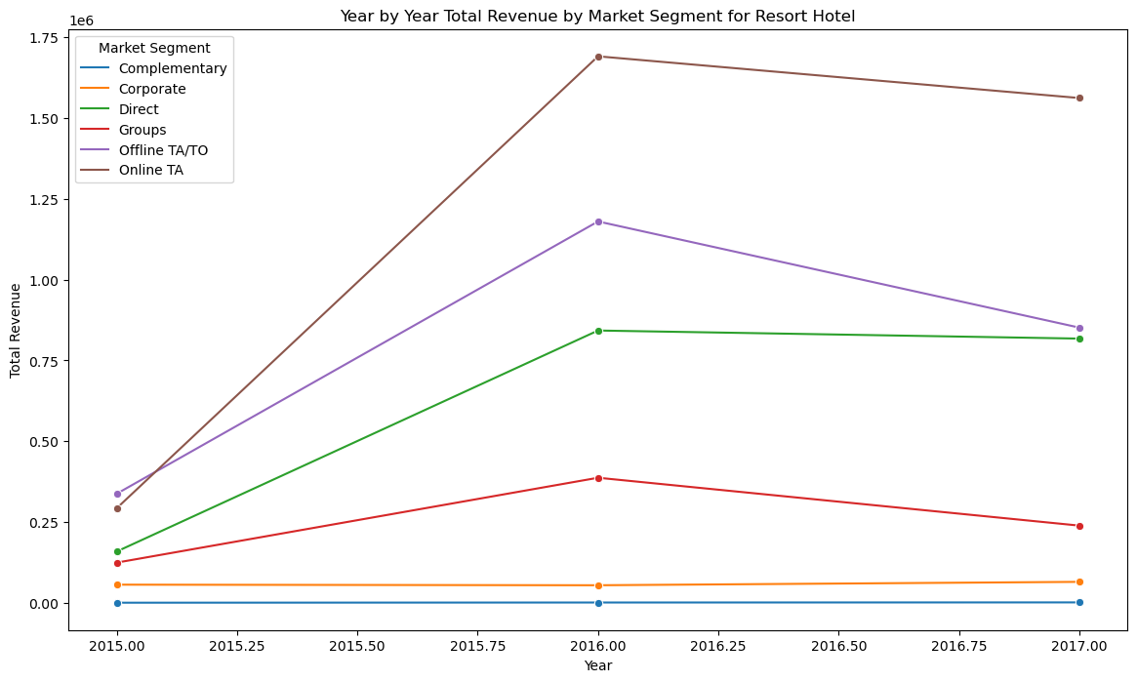

Slide 23

Geography Deo

Slide 24

Conclusion
Judy
Notes:
Judy - conclusion

